Slide 1
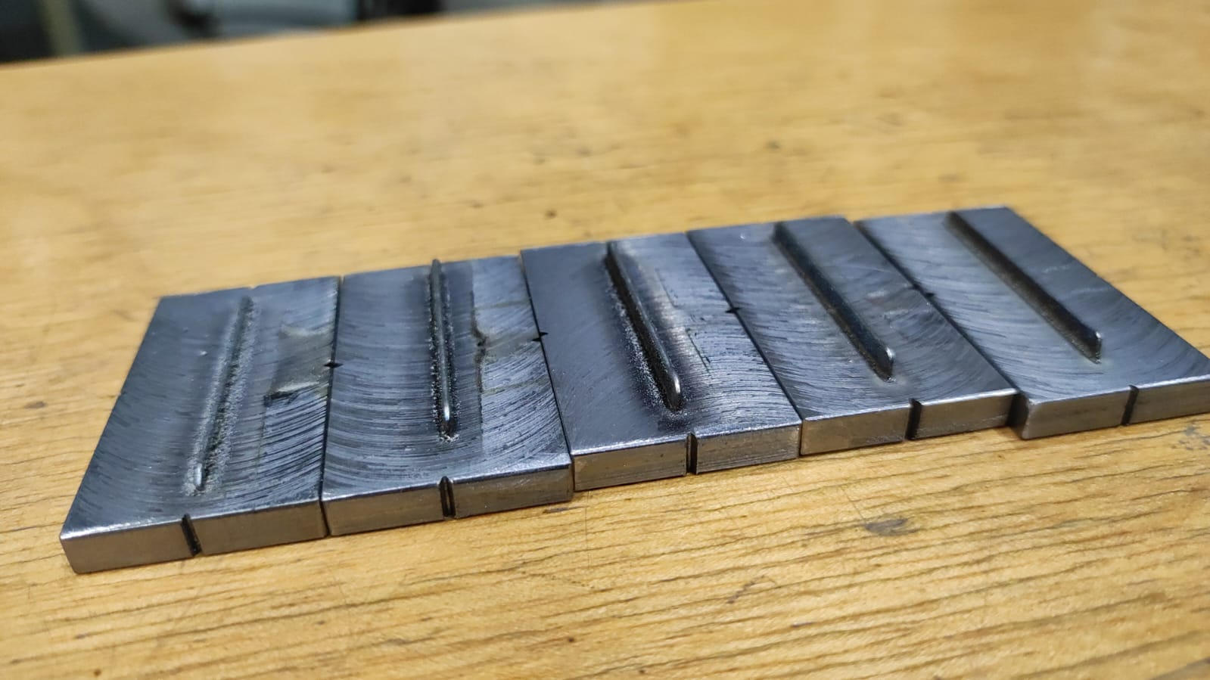

Slide 2
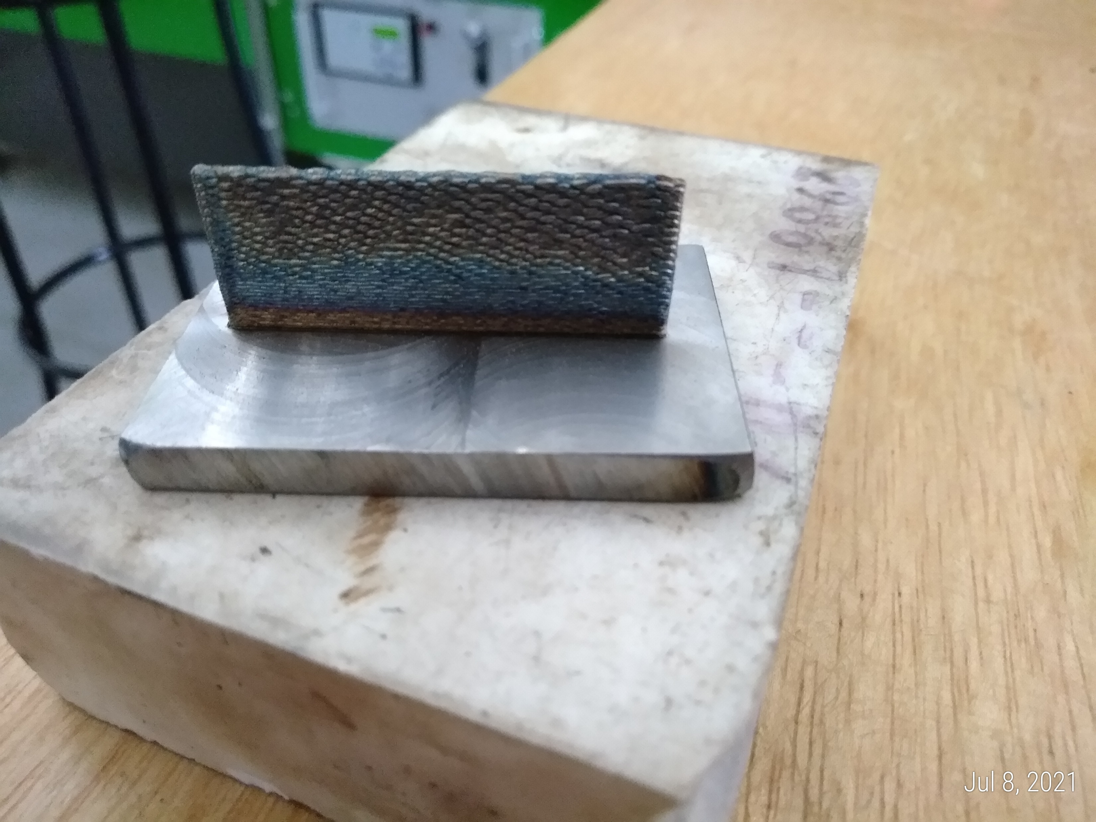
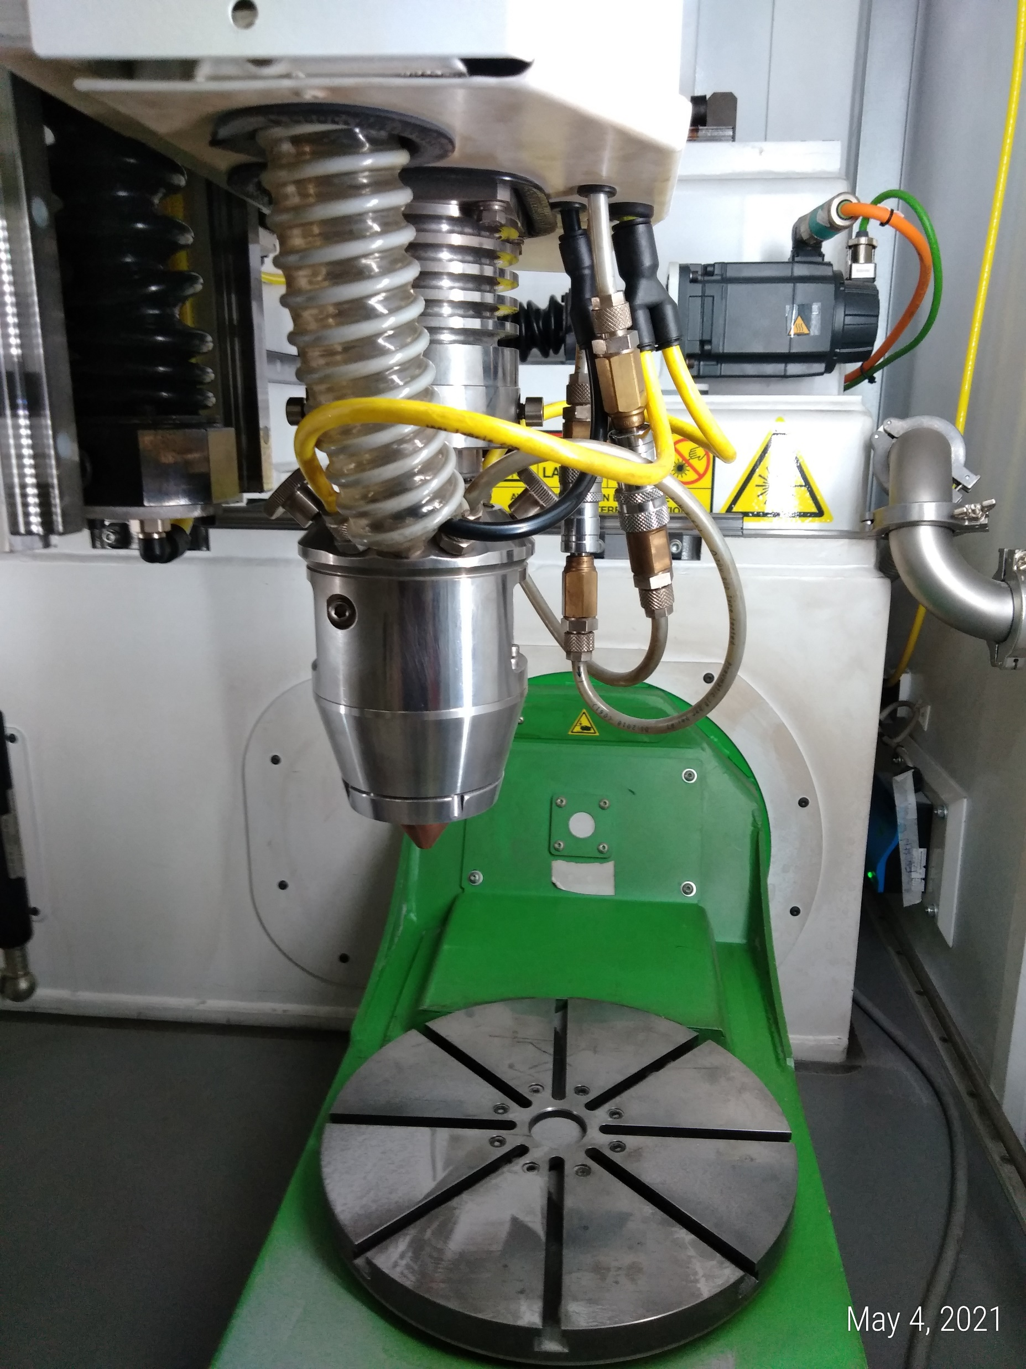
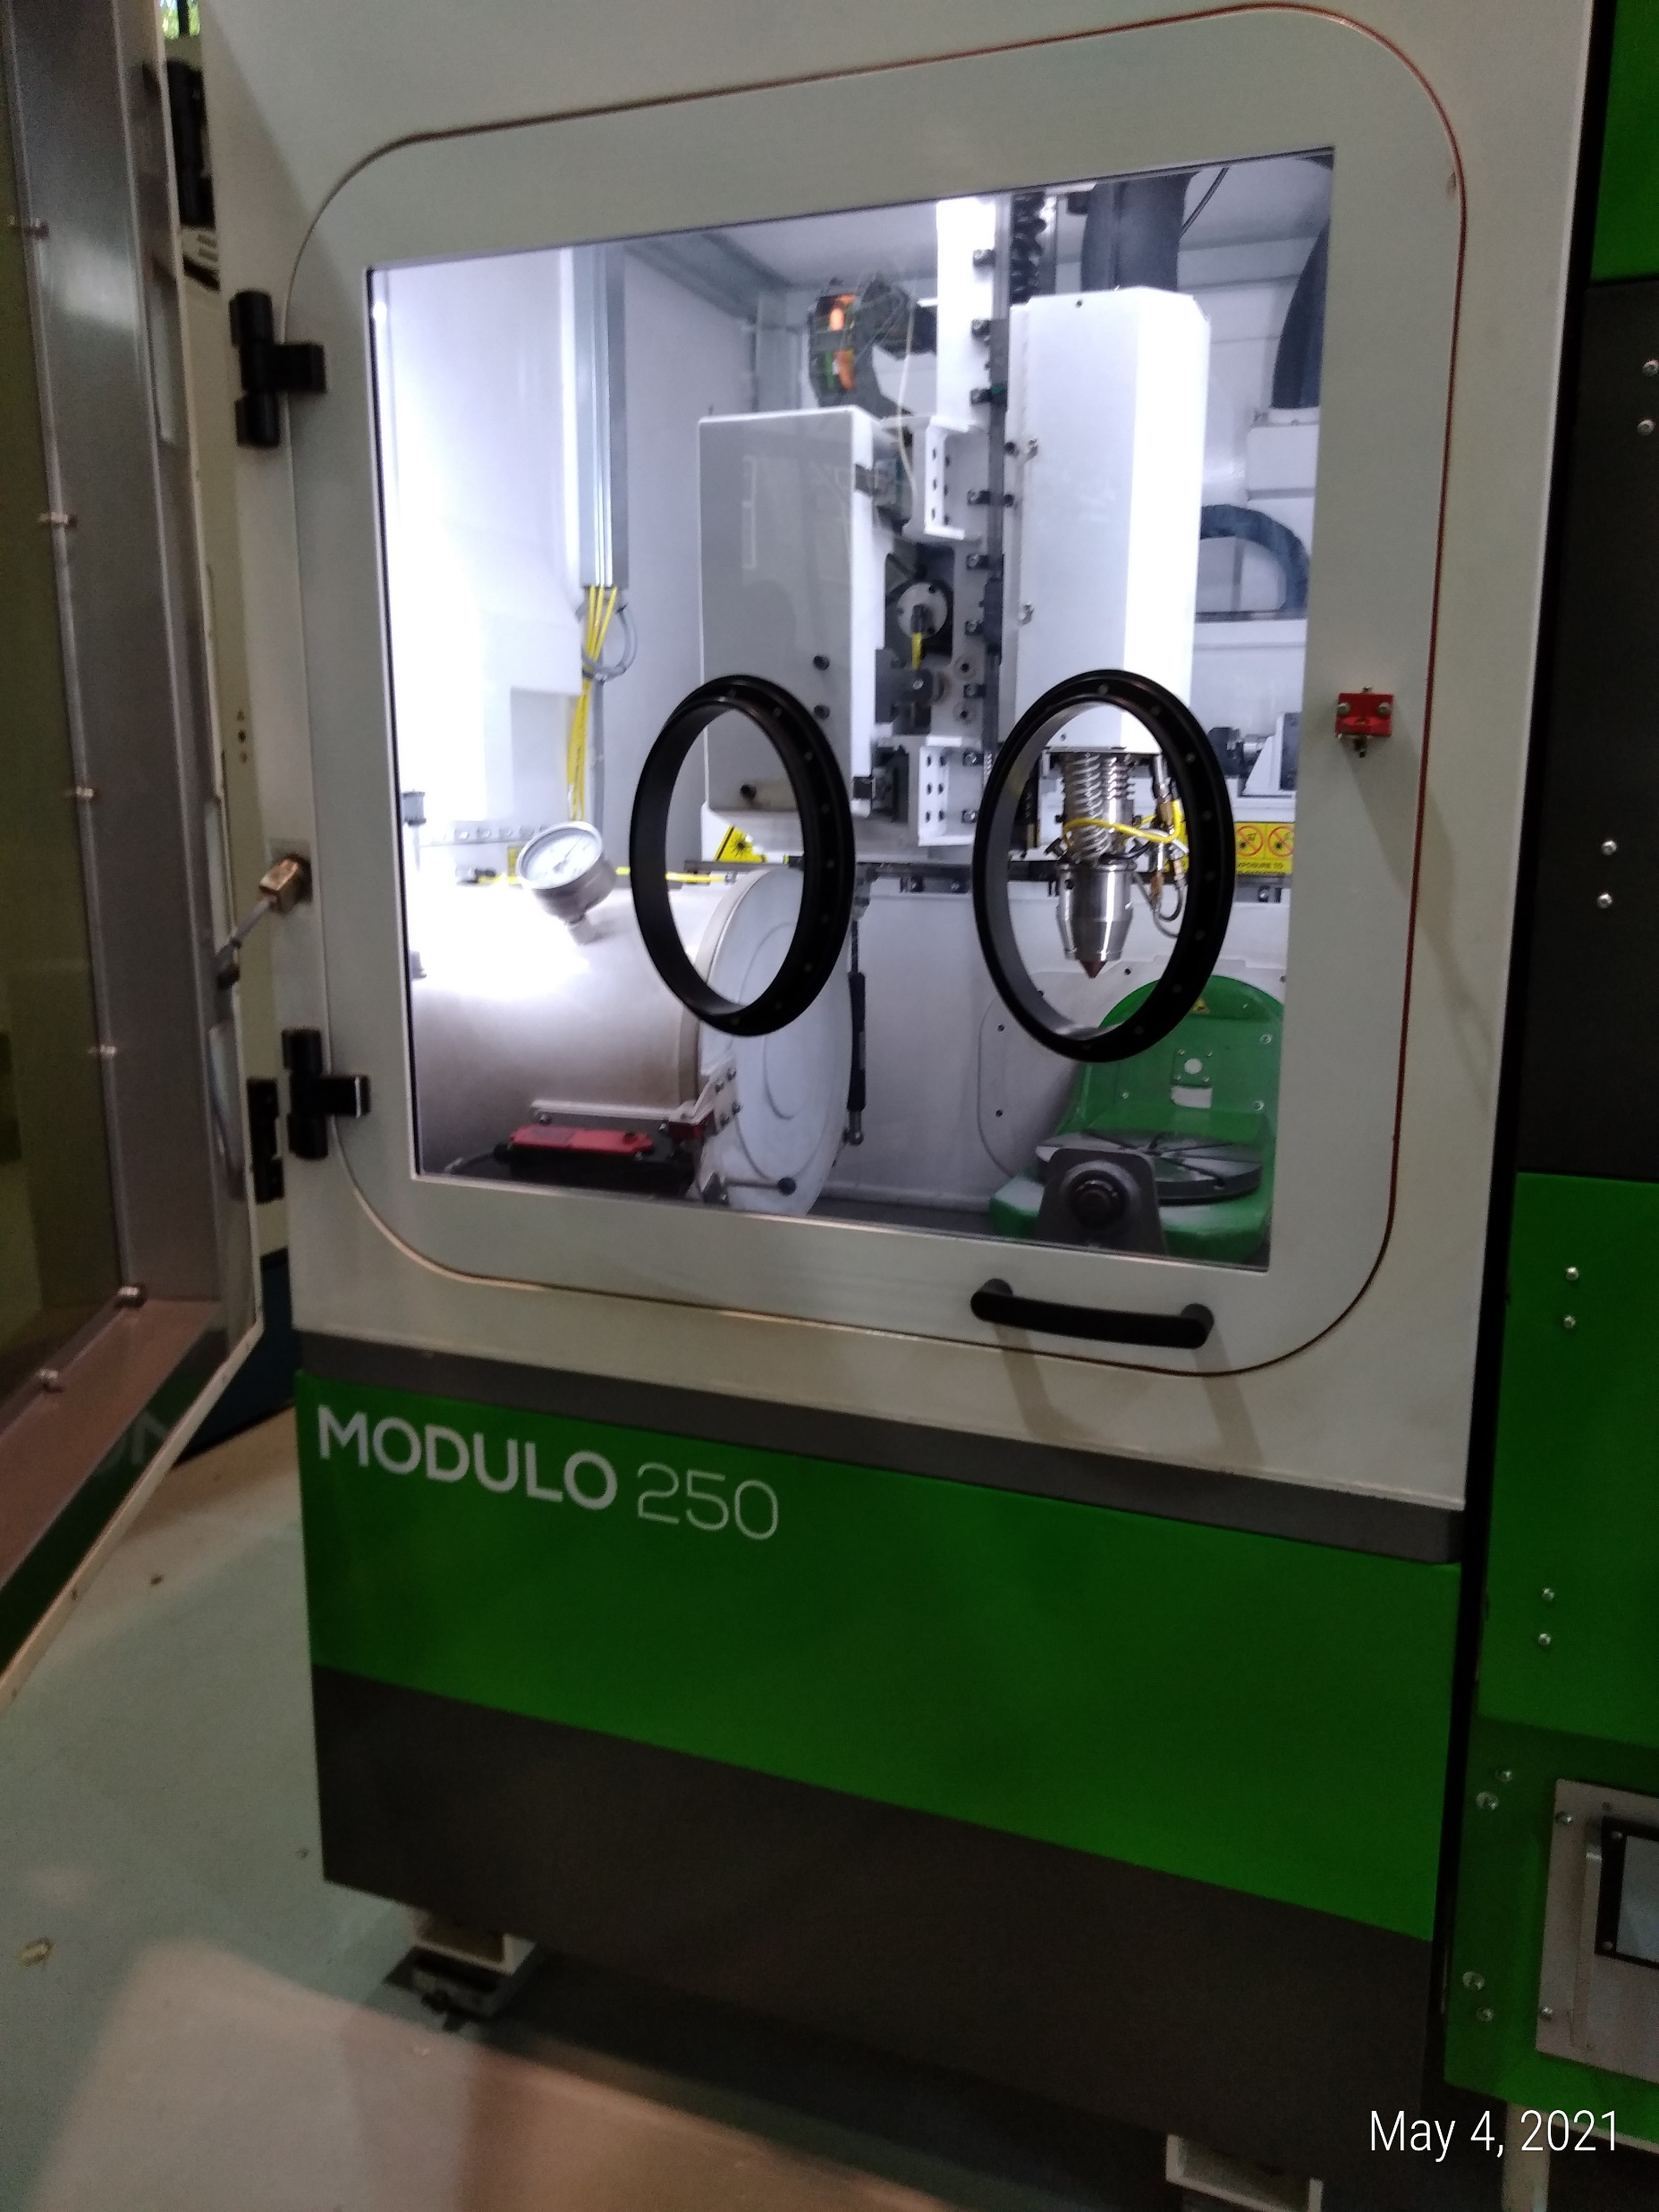
Proposal
Níquel
a high-strength, nickel-based superalloy containing 50–55% nickel, 17–21% chromium, and significant additions of niobium, molybdenum, and iron. It resists extreme heat up to 700°C (1300°F) and severe corrosion, making it ideal for aerospace and gas turbines
Single walls made of Inconel 718 by DED-L
  20 layers, different fabrication parameters; fabrication layers over an insulating brick
  Samples for residual stresses measurements at DESY
  Samples for microstructural characterization and micro tensile tests
Machine: BEam Modulo 250

Slide 3
z
x
y
Building direction
5
4
ø1
y
12.5
12.5
40
z
x
25
5
5
25
TC1(upper surface)
TC3 (hole)
TC2(upper surface)
25
6.25
TC4(upper surface)
50

Slide 4
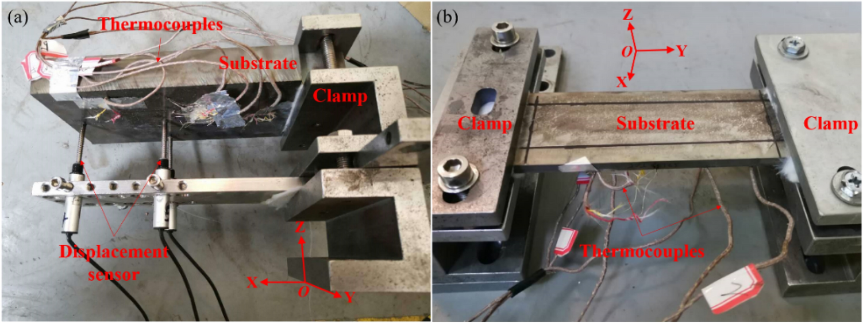
Previous Experiments – Michele et al.
Lu, X., Chiumenti, M., Cervera, M. et al. Mitigation of residual stresses and microstructure homogenization in directed energy deposition processes. Engineering with Computers 38, 4771–4790 (2022). https://doi.org/10.1007/s00366-021-01563-9

Slide 5
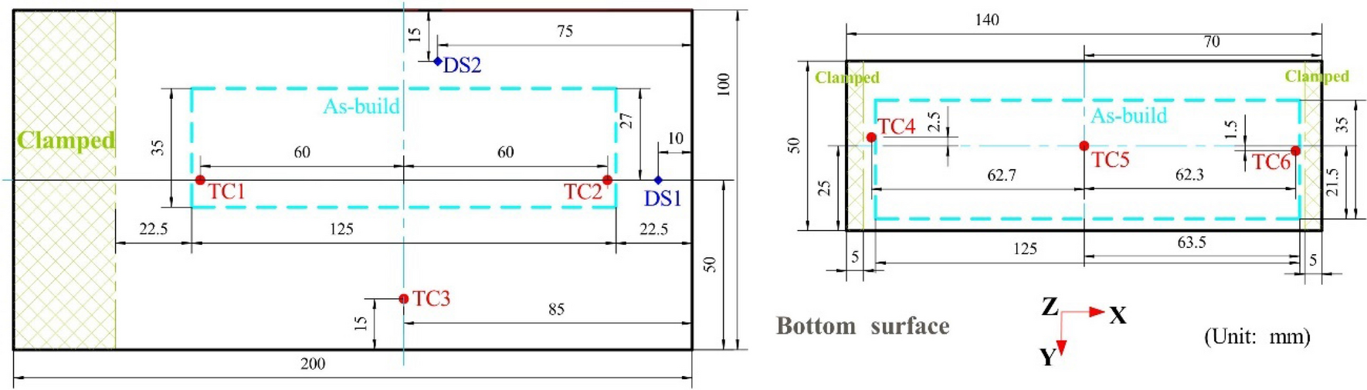
Lu, X., Chiumenti, M., Cervera, M. et al. Mitigation of residual stresses and microstructure homogenization in directed energy deposition processes. Engineering with Computers 38, 4771–4790 (2022). https://doi.org/10.1007/s00366-021-01563-9

Slide 6
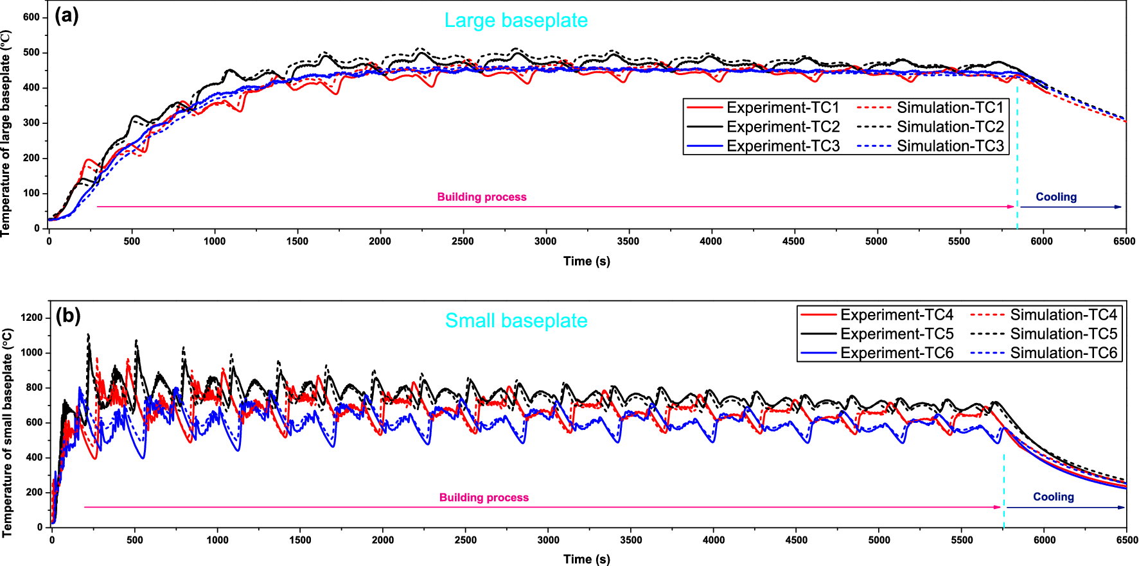
Lu, X., Chiumenti, M., Cervera, M. et al. Mitigation of residual stresses and microstructure homogenization in directed energy deposition processes. Engineering with Computers 38, 4771–4790 (2022). https://doi.org/10.1007/s00366-021-01563-9

Slide 7
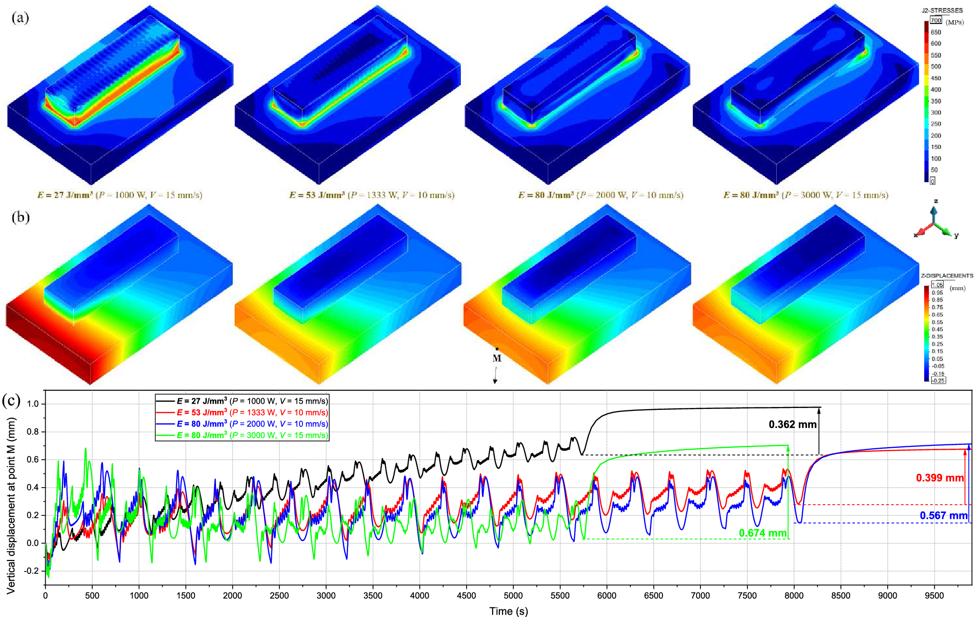

Slide 8
Previous proposal:
20 layers was not a great idea:
RS probably higher ... in substrate due to samples’ sizes.

Slide 9
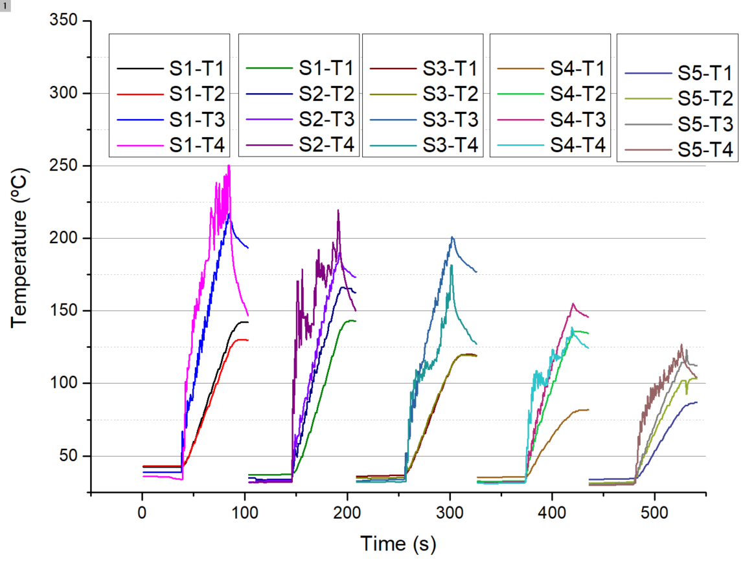

Slide 10
New proposal suggestion:
AM (L-DED)
Numerical simulation of RS
Experimental RS measurements (P61A)
Single walls made of Inconel 718 by DED-L
  20-30 mm in height, three different fabrication procedures; fabrication over an insulating brick
  Samples for residual stresses measurements at DESY
  Samples for microstructural characterization and micro tensile tests
  Numerical simulation
Machine: BEam Modulo 250

Slide 11
z
20
x
y
Building direction
5
4
ø1
y
12.5
12.5
50
z
x
25
5
5
25
TC1(upper surface)
TC3 (hole)
TC2(upper surface)
25
6.25
TC4(upper surface)
70

Slide 12
New deposition strategies:
Conditions
1
2
Dwell time in between depositions
10s?
3

Slide 13
Conditions | Measuring spots
 | Center |  |  | Side
 | C-H1 | C-H2 | C-H3 | S-H1 | S-H2 | S-H2
Condition 1 | x | x | x | x | x | x
Condition 2 | x | x | x | x | x | x
Condition 3 | x | x | x | x | x | x
Residual stress measurements
Center Side
1
1
z
2
2
x
y
Building direction
3
3

Slide 14
https://easi-stress.eu/

Slide 15
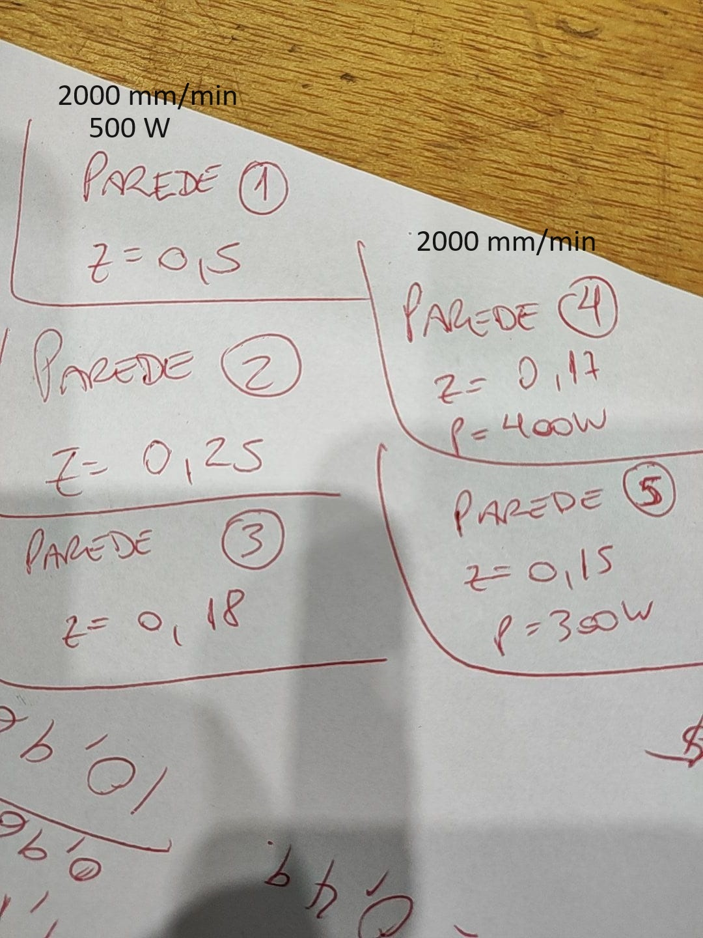

Slide 16
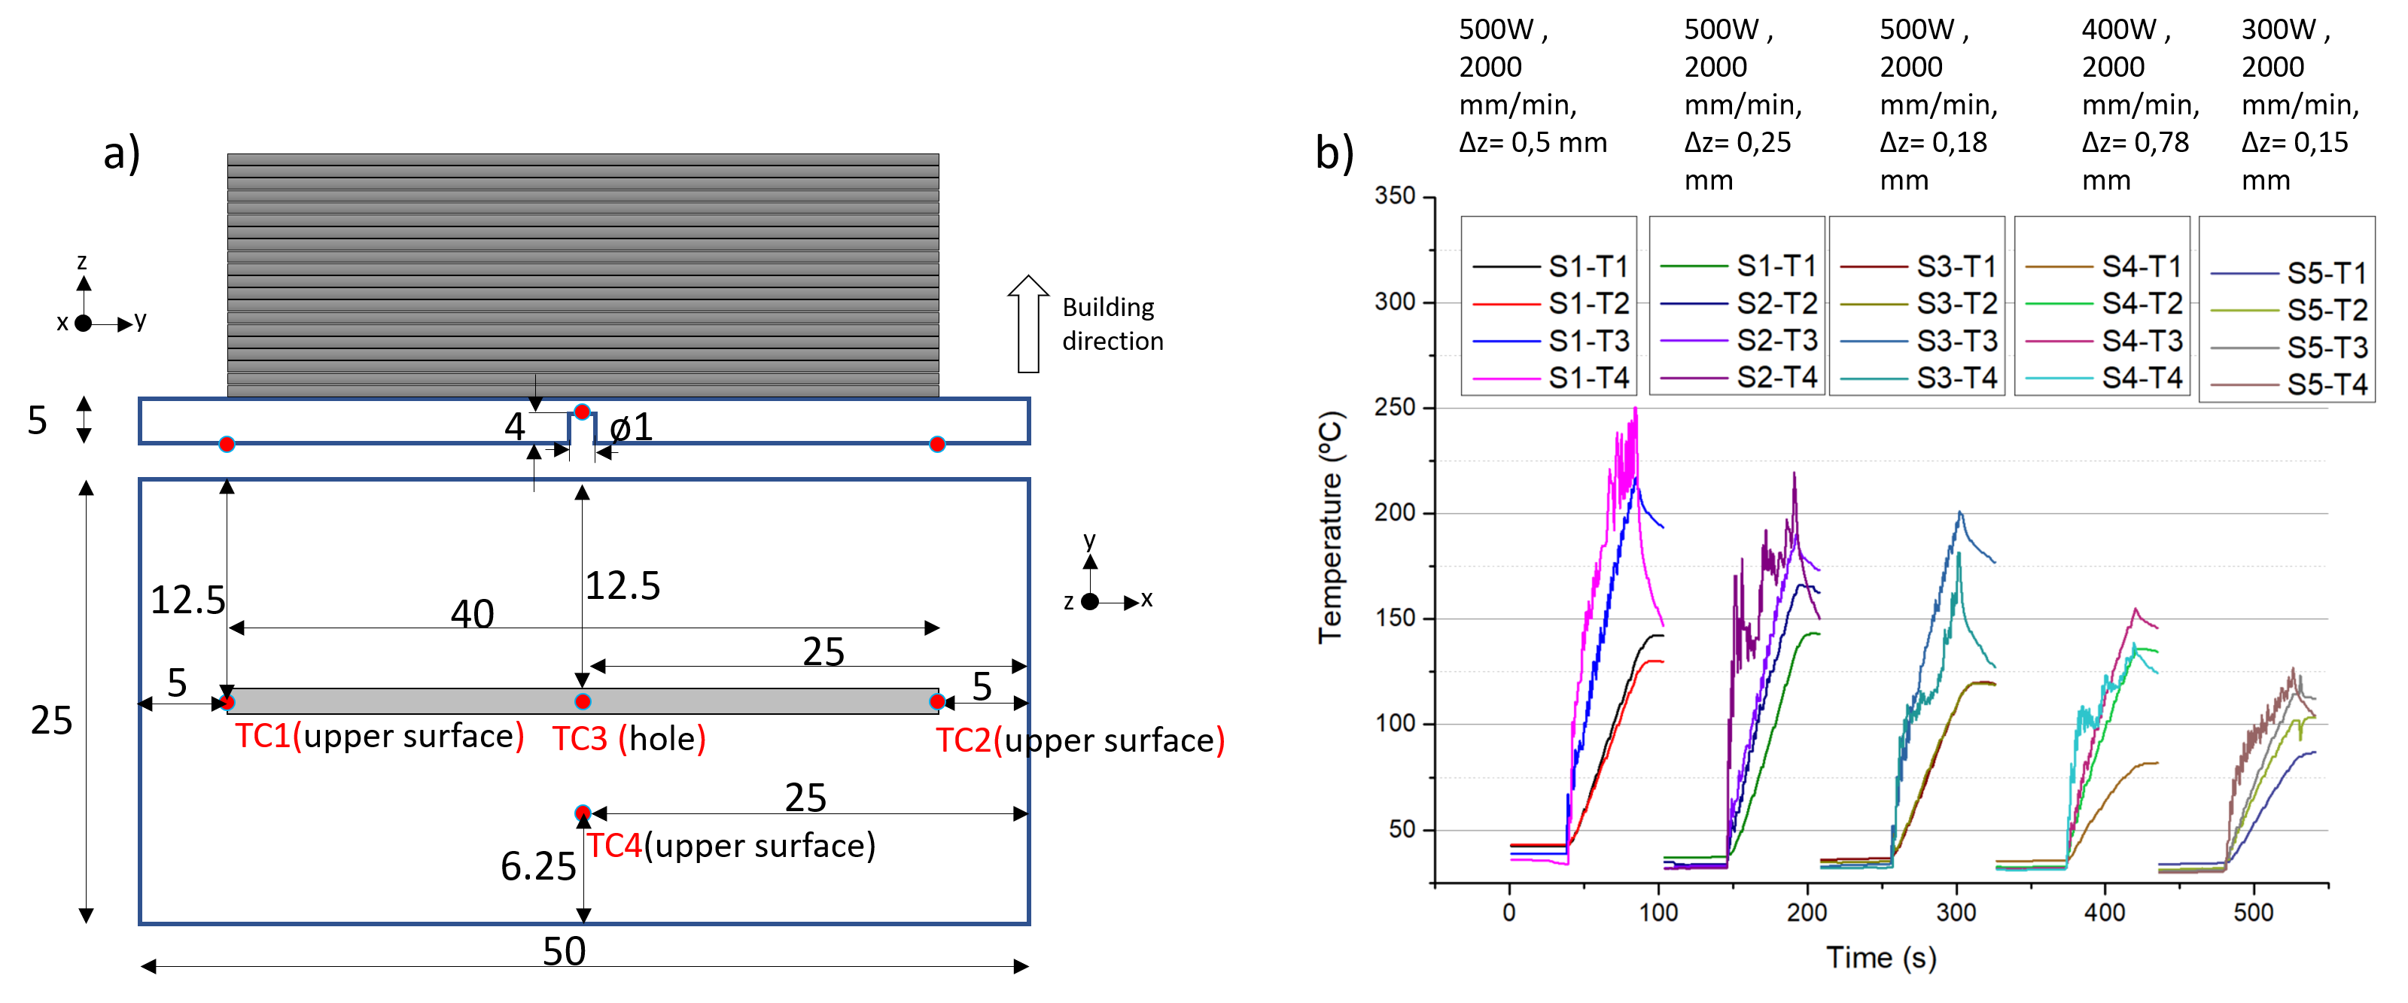

Slide 17
500W , 2000 mm/min, Δz= 0,5 mm
500W , 2000 mm/min, Δz= 0,25 mm
500W , 2000 mm/min, Δz= 0,18 mm
400W , 2000 mm/min, Δz= 0,78 mm
300W , 2000 mm/min, Δz= 0,15 mm
a)
b)
z
x
y
Building direction
5
4
ø1
y
12.5
12.5
40
z
x
25
5
5
25
TC1(upper surface)
TC3 (hole)
TC2(upper surface)
25
6.25
TC4(upper surface)
50

